Slide 1

LUNCH SPECIALS
WING FLAVORS
Meal comes with French fries and a drink (❷ - Drink only)
Hot Extra Hot Honey Hot Mild Medium Extra Mild
Lemon Pepper Ranch
Honey Mustard Cajun
Teriyaki Hot Teriyaki BBQ Garlic Pepper Honey Garlic Pepper
Plain
Meal Entree
❶
Taco (Fish / Chicken / Pulled Pork)
5.39
3.89
……….....
❷
Egg Rolls (Pork / Vegetable) & Fried Rice
...
5.49
4.99
❸
……….
5.79
4.29
Smoked Pulled Pork Sandwich
❹
Chicken Sandwich
………….…………....
5.39
3.89
❺
Hamburger
…………………………….…....
5.39
3.89
❻
Philly Sandwich (Beef / Chicken)
……........
5.79
4.29
❼
…….
5.49
3.99
1 piece Fish (Tilapia / Catfish / Whiting)
❽
4 piece Wings or Boneless Bites
….….
5.29
3.79
❾
1 piece Fish and 4 piece Wings or Boneless Bites
..….
6.99
5.49
❿
4 piece Butterfly Shrimps
……….….….
4.79
3.29
❶❷❸❹❺❻❼❽❾❿⓫⓬❶❷❸❹❺❻❼❽❾❿⓫⓬

Slide 2
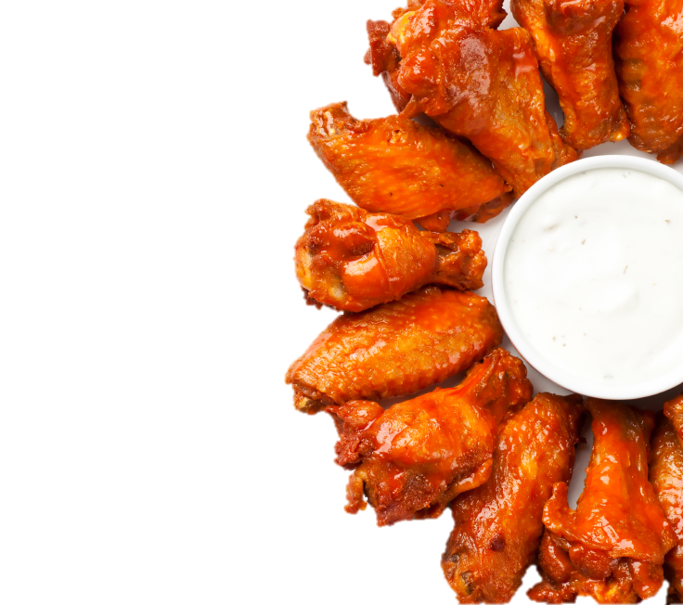
COMBO MEALS
Comes with a side and a drink (❺ & ❼ - Drink only)
❶
10 piece Wings or Boneless Bites
7.99
..........
❷
............
6.99
Philly Sandwich - Beef / Chicken
❸
6 piece Wings or Boneless Bites
..........
6.49
❹
Philly Sandwich & 6 pc Wings or Boneless Bites
8.99
….........
❾
Deluxe Sandwich Smoked Pulled Pork / Chicken / Beef
6.49
❺
Shrimp Fried Rice & 6 pc Wings or Boneless Bites plus a drink
.....
8.49
❿
………...
5.99
Wraps - Fish / Chicken
❻
2 piece Fish (fried or grilled)
…..…....
6.99
⓫
……....
6.99
2 Tacos - Fish / Chicken
❼
Shrimp Fried Rice & 10 pc Wings or Boneless Bites plus a drink
9.99
⓬
16 piece Wings
..........................
11.49
....
❽
1 piece Fish & 6 piece Wings or Boneless Bites
8.99
Substitute a side to a fried rice (Shrimp / Chicken / Beef ) with $1.59. Vegetable - $0.50
…..…....
❶❷❸❹❺❻❼❽❾❿⓫⓬❶❷❸❹❺❻❼❽❾❿⓫⓬

Slide 3
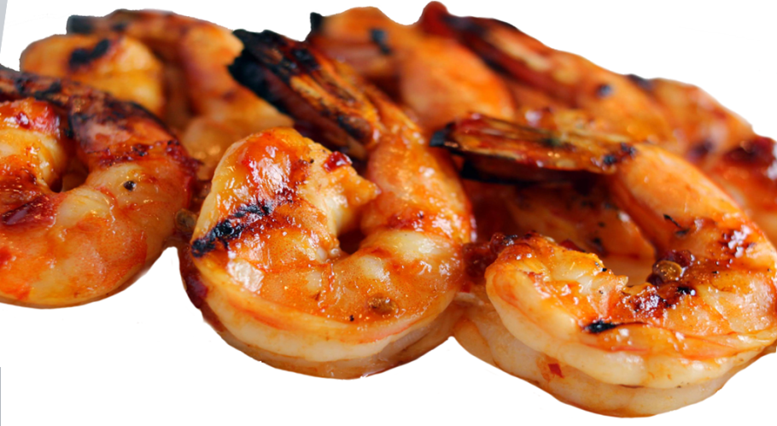
Fish Only
DELUXE SANDWICHES
GRILLED SHRIMP
CHICKEN TENDERS
w/ F fries
Shrimp Only
w/ F fries
w/ F fries
5.49
6.99
6 pcs
5.99
7.49
2 pcs
3.49
4.99
Philly Chicken / Beef
8 pcs
7.99
9.49
4 pcs
5.49
6.99
Chicken
4.49
5.99
6 pcs
7.49
8.99
Pulled Pork
5.99
BUTTERFLY SHRIMP
4.49
Shrimp Only
w/ F fries
FRIED RICE
Burger
5.99
4.49
6 pcs
4.49
5.99
Small
Large
FISH
8 pcs
5.49
6.99
Vegetable
2.99
4.49
w/ F fries
SIDE ORDERS
Beef / Chicken
3.99
5.99
2 pcs
5.49
6.99
Small
Large
Shrimp / House
4.49
6.49
3 pcs
6.99
8.49
French Fries
1.99
2.99
Tilapia / Catfish / Whiting
Egg Roll
1.99
2.99
SALAD
Cole Slaw
1.99
2.99
Chicken / Fish Salad
5.99
WINGS
Wings Only
w/ F fries
Onion Rings
2.49
3.99
6 pcs
4.99
5.99
Hushpuppies
2.49
3.99
10 pcs
6.99
7.99
Fried Okra
2.49
3.99
20 pcs
12.59
13.59
Garden Salad
2.49
3.99

Slide 4



Wings Only
w/ Side
Hot Extra Hot Honey Hot
Mild Medium Extra Mild
Lemon Pepper Garlic Pepper Honey Garlic Pepper
Ranch Cajun Honey Mustard
Teriyaki Hot Teriyaki
BBQ Plain
6 Pcs
$4.49
$5.49
10 Pcs
$6.99
$7.99
20 Pcs
$13.99
$15.99
30 Pcs
$19.99
$22.99
50 Pcs
$31.99
$33.99
75 Pcs
$43.99
$45.99
100 Pcs
$59.99
$63.99
Fish Only
w/ Side
2 Pcs
$5.49
$6.99
3 Pcs
$6.99
$8.49
Philly Sandwich
$5.49
4 Pcs
$9.99
$10.99
Philly w/ Side
$6.99
6 Pcs
$13.99
$14.99
Philly w/ 6 Pc Wings
$8.49
Tilapia & Catfish - can be grilled, black cajun, or lemon pepper.
Whiting – Fried Only.
Comes with one side order, coleslaw, and tarter sauce.
Grilled extra lean Steak or Chicken & Onion, Bell pepper, Mushroom, Mayo with Melted White Cheese

Slide 5




